Slide 1
Secure data hiding in images using steganography
CAPSTONE PROJECT
Presented By : Mitalkumar
Student Name : Mitalkumar Kidecha
College Name & Department : Shantilal Shah Engineering College ,
Information Technology Department

Slide 2
OUTLINE
Problem Statement
Technology used
Wow factor
End users
Result
Conclusion
Git-hub Link
Future scope

Slide 3
Problem Statement
Data security : Emphasize the importance of secure data transmission and storage, especially in today's digital age.
Steganography vs. cryptography : Explain how steganography differs from cryptography and the benefits of using steganography for secure data hiding.
Real-world applications : Discuss potential real-world applications of secure data hiding in images, such as protecting sensitive information or intellectual property.

Slide 4
Technology used
Programming languages and tools : Python language , Python IDLE
Libraries : cv2 , OpenCV
Steganography techniques : Explore various steganography techniques,
such as:
Least Significant Bit (LSB) substitution
Spatial domain steganography

Slide 5
Wow factors
High-capacity data hiding: Investigate techniques for hiding large amounts of data within images while maintaining image quality.
Steganalysis resistance: Design your steganography technique to be resistant to steganalysis attacks, which aim to detect hidden data.
Real-time data hiding and extraction: Implement a real-time system for data hiding and extraction, allowing for efficient and secure data transmission.

Slide 6
End users
Military and Defense: To securely transmit sensitive information, such as battlefield coordinates or intelligence reports.
Government Agencies: For secure communication, such as diplomatic correspondence or classified information.
IT Company: To protect intellectual property, trade secrets, or confidential business information.
Financial Institutions: To secure financial transactions and protect sensitive customer information.

Slide 7
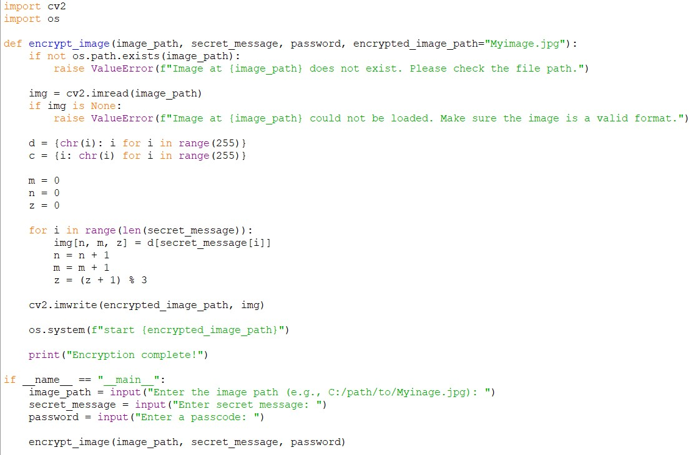
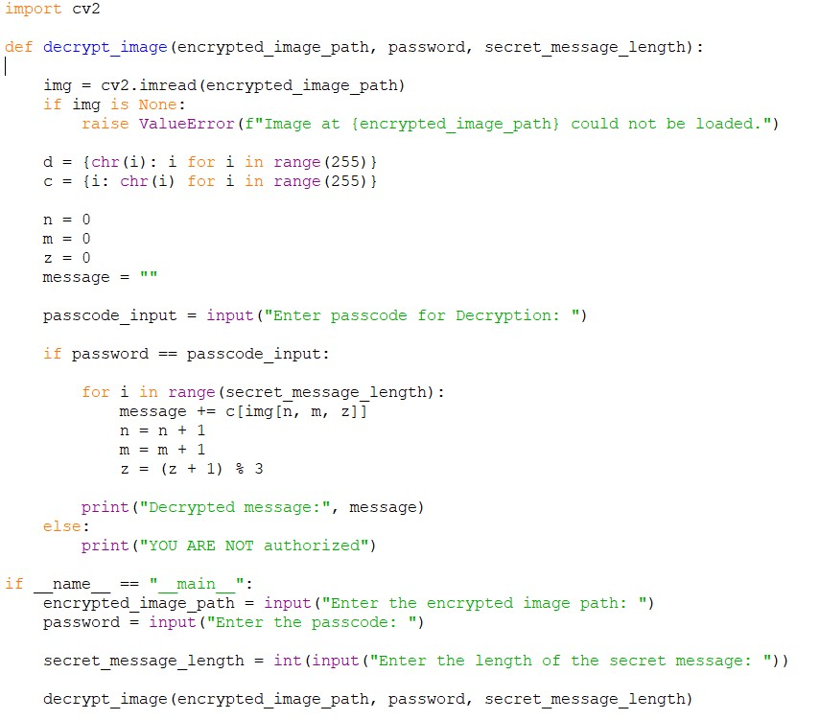
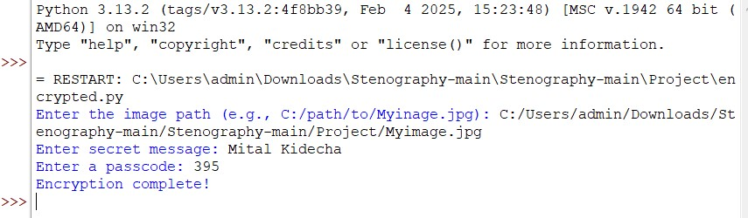
Results

Slide 8
Conclusion
This project successfully implemented secure data hiding in images using steganography. Spatial domain steganography was utilized to embed secret data within images, ensuring high-capacity data hiding while maintaining image quality.
Key benefits include high-capacity data hiding, secure data transmission, low computational complexity, and compatibility with various image formats.
Future enhancements can focus on exploring advanced steganography techniques to further improve security and capacity.
This project contributes to the development of secure data transmission methods, addressing the growing need for protecting sensitive information in today's digital age.

Slide 9
GitHub Link
https://github.com/Mitalkumar05/aicte.project.git

Slide 10
Future scope(optional)
Multimedia steganography: Explore steganography techniques for other multimedia formats, such as audio or video.
Steganography for IoT security: Investigate the application of steganography for securing Internet of Things (IoT) devices and networks.

Slide 11
THANK YOU

